Slide 1

The Movie Study by Malio Mayo
An analysis of IMDb Movie Data from 2006-2016

Slide 2

Introduction
Movies have been a pivotal part of most people’s lives, whether it was a movie you saw as a kid that changed your view on the world, or a movie about a funny dinosaur that just made you laugh. Everyone loves a good movie, but what about the movie made it so great?

Slide 3

Questions to be answered.
Year with the most releases?
What movie did the best? Who directed it?
What movie did the worst? Who directed it?
How does IMDb’s rank of movies compare to the ratings?
Does Genre affect how the movie does?

Slide 4
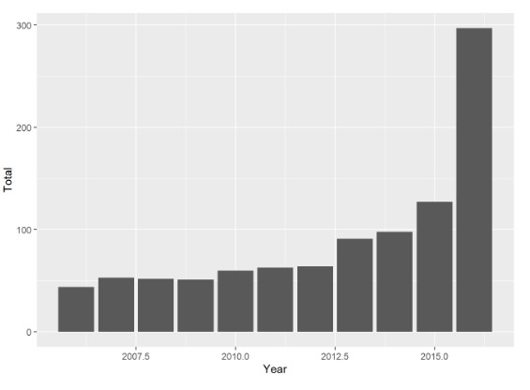
Year with most Releases
2016

Slide 5
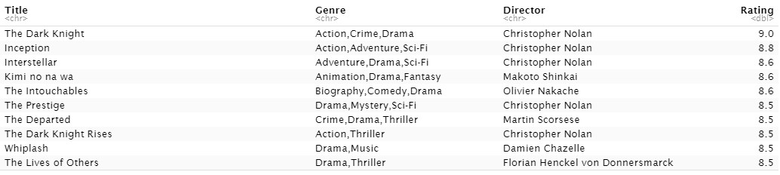
What Movie did the best?
The Dark Knight, directed by Christopher Nolan, it received a rating of 9.0.

Slide 6
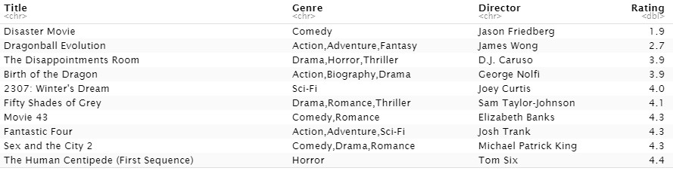
What Movie did the worst?
Disaster Movie, directed by Jason Friedberg, it received a rating of 1.9.

Slide 7
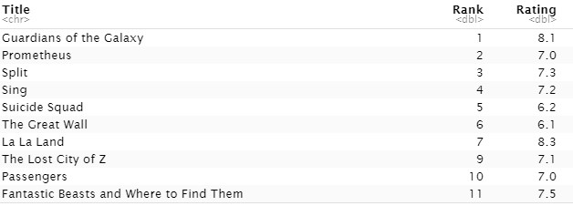
IMDb Rank VS Universal Ratings
IMDb’s Ranking is done by popular vote of IMDb’s users, while the rating is the universal rating of the movie by the audiences.

Slide 8
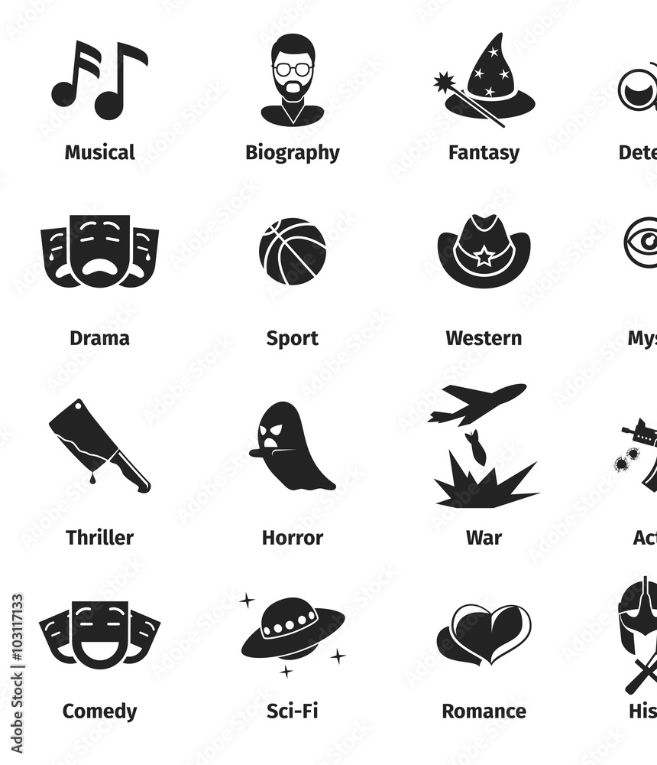
What Genre did the best?
Most of the movies in the top 20 have at least Action, Drama, or Adventure listed as genre which leads to the conclusion that those movies do better than others.

Slide 9

Best Director
Out of the top 10 movies on the list, Christopher Nolan directed 5 of them.

Slide 10
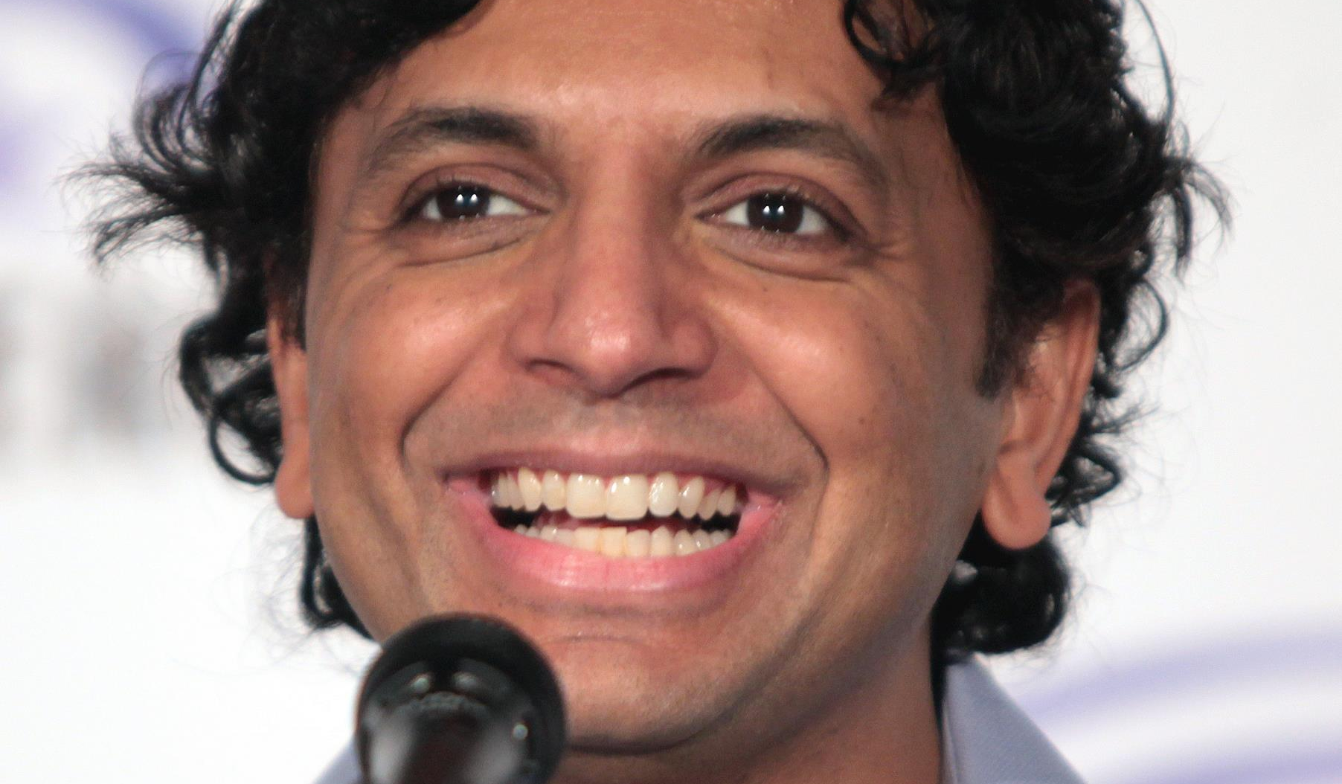
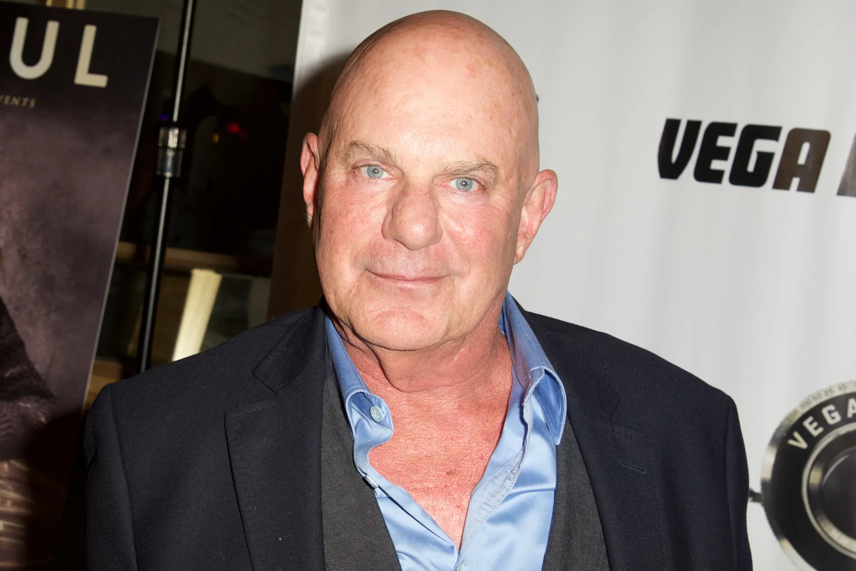
Worst Director(s)
In the worst 50 movies rated in the 2006-2016 period, M. Night Shyamalan and Rob Cohen made 2 movies in the 50 worst rated movies.

Slide 11
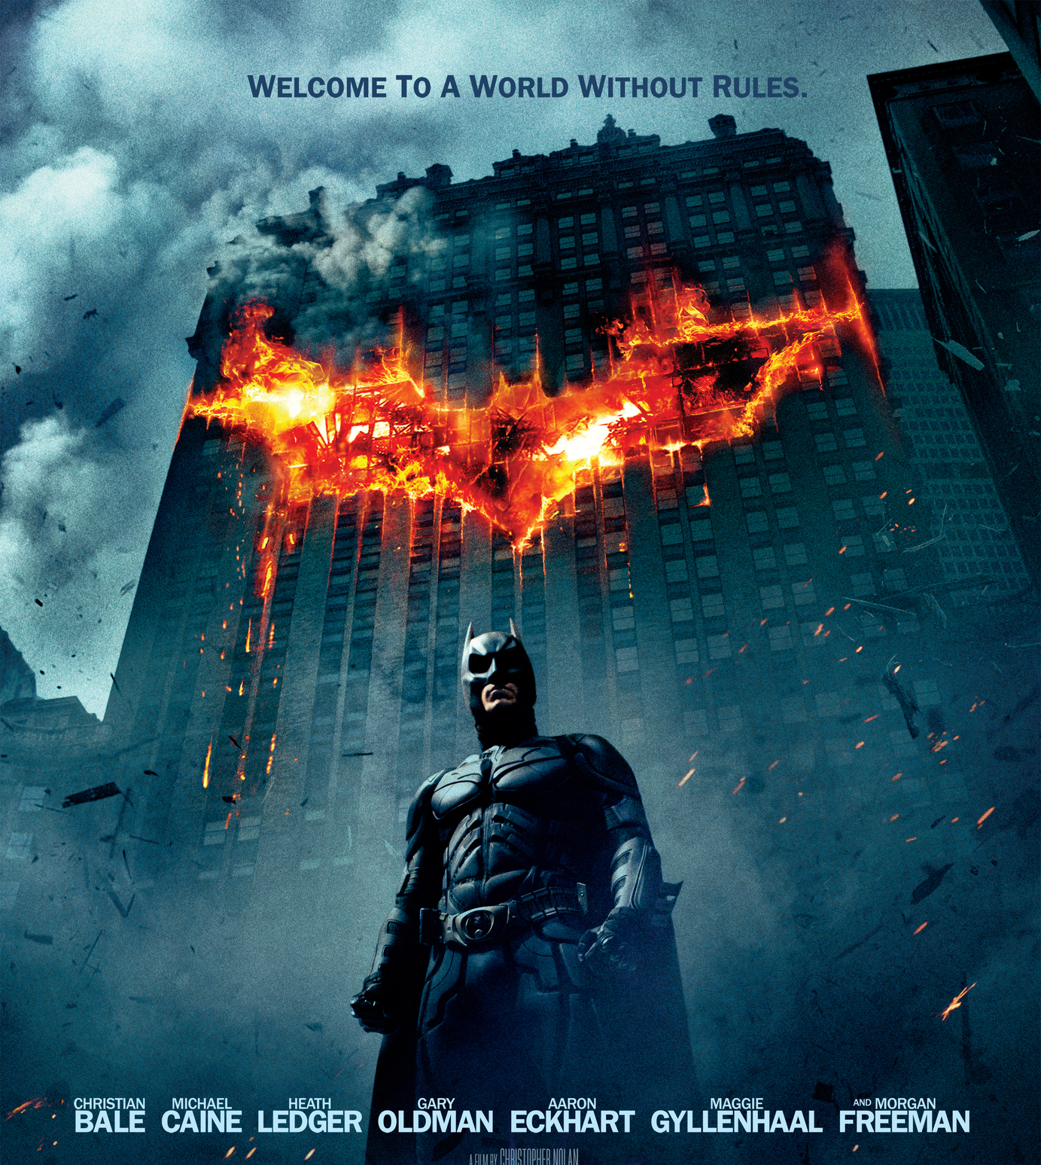
Conclusions
Genre does matter.
Christopher Nolan is an Amazing Director.
2006-2016 had some great movies come out in a short period of time.

